Slide 1
자폐아동의 사회성발달 학습을 위한
프로그램 개발
D조 삼김이최고

Slide 2
Front-end

Slide 3
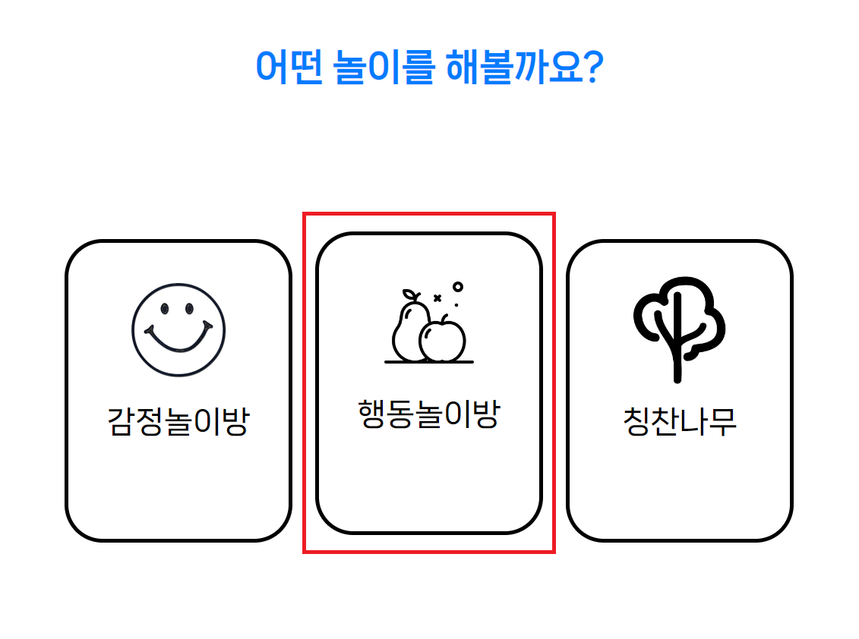
메인페이지
Notes:
This week, we implemented a front-end contents for the “행동놀이방.”

Slide 4
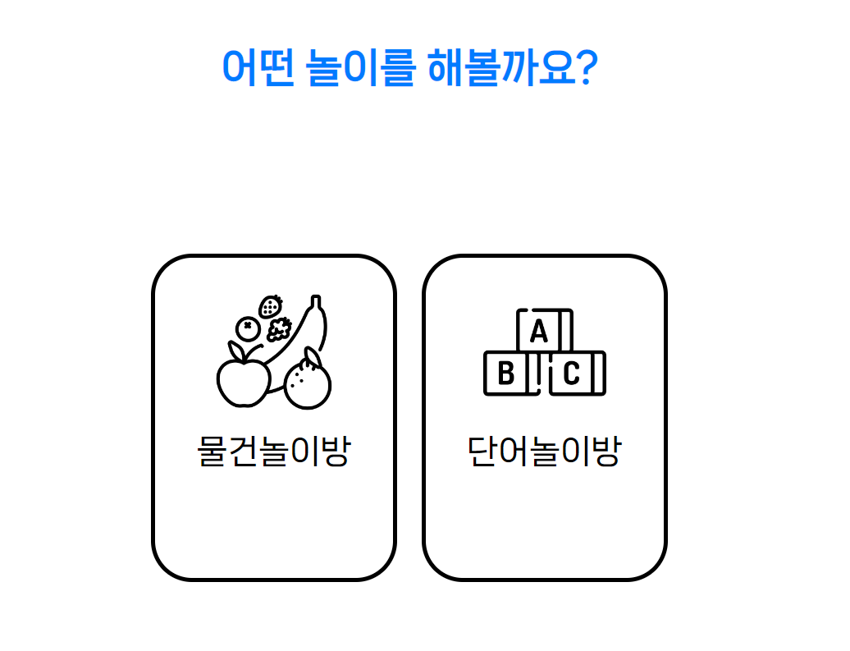
행동놀이방
Notes:
행동놀이방 is divided into two pages: 물건놀이방 and 단어놀이방.
The two pages are having the same form, but 물건놀이방 recognizes real objects, while 단어놀이방 recognizes the letters written on the word cards.
We have implemented the OCR initial model for the 단어놀이방, and we will connect them for following week.

Slide 5
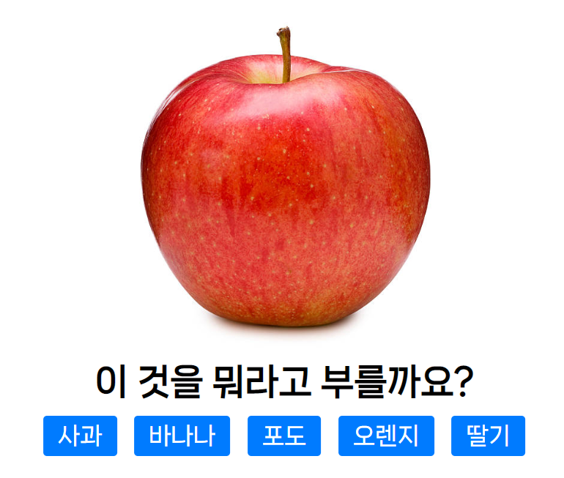
물건놀이방
Notes:
This is an example screen of 물건놀이방.
In this example, there are only five choices for fruits, but there will be added additional choices for different datasets.

Slide 6

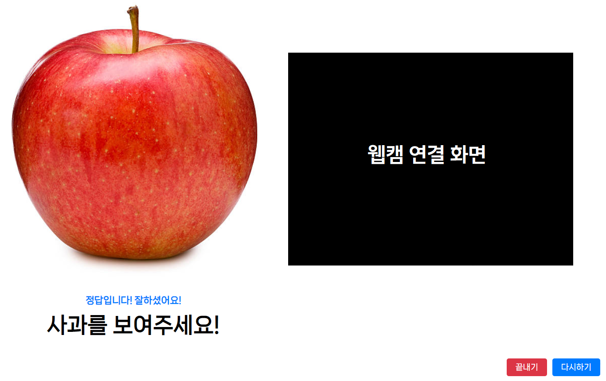
물건놀이방 성공화면
Notes:
This is an example screen when the user get the correct answer for the 물건놀이방.
If user show an actual object through a webcam which user’s parents have prepared before, check if the object matches the answer through the yolo model and give them a point.

Slide 7
행동놀이방 AI Model

Slide 8
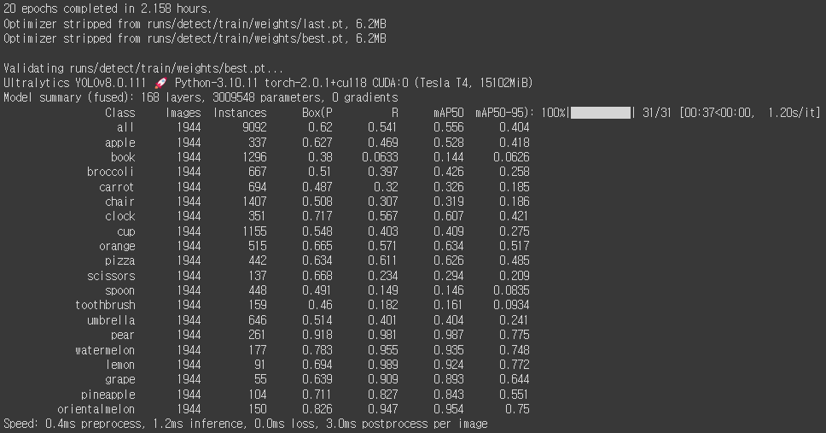
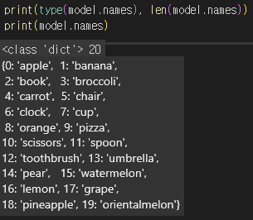
행동 놀이방 DataSet
→ Trained as a YOLOv8 Model For 20 epoch
▷About 40,000↑ Images of 20 Class (Fruites and Supplies)
Notes:
We trained about 40,000 images of 20 classes for 20 epoch during 2 hours in colab, so this is our code result.

Slide 9
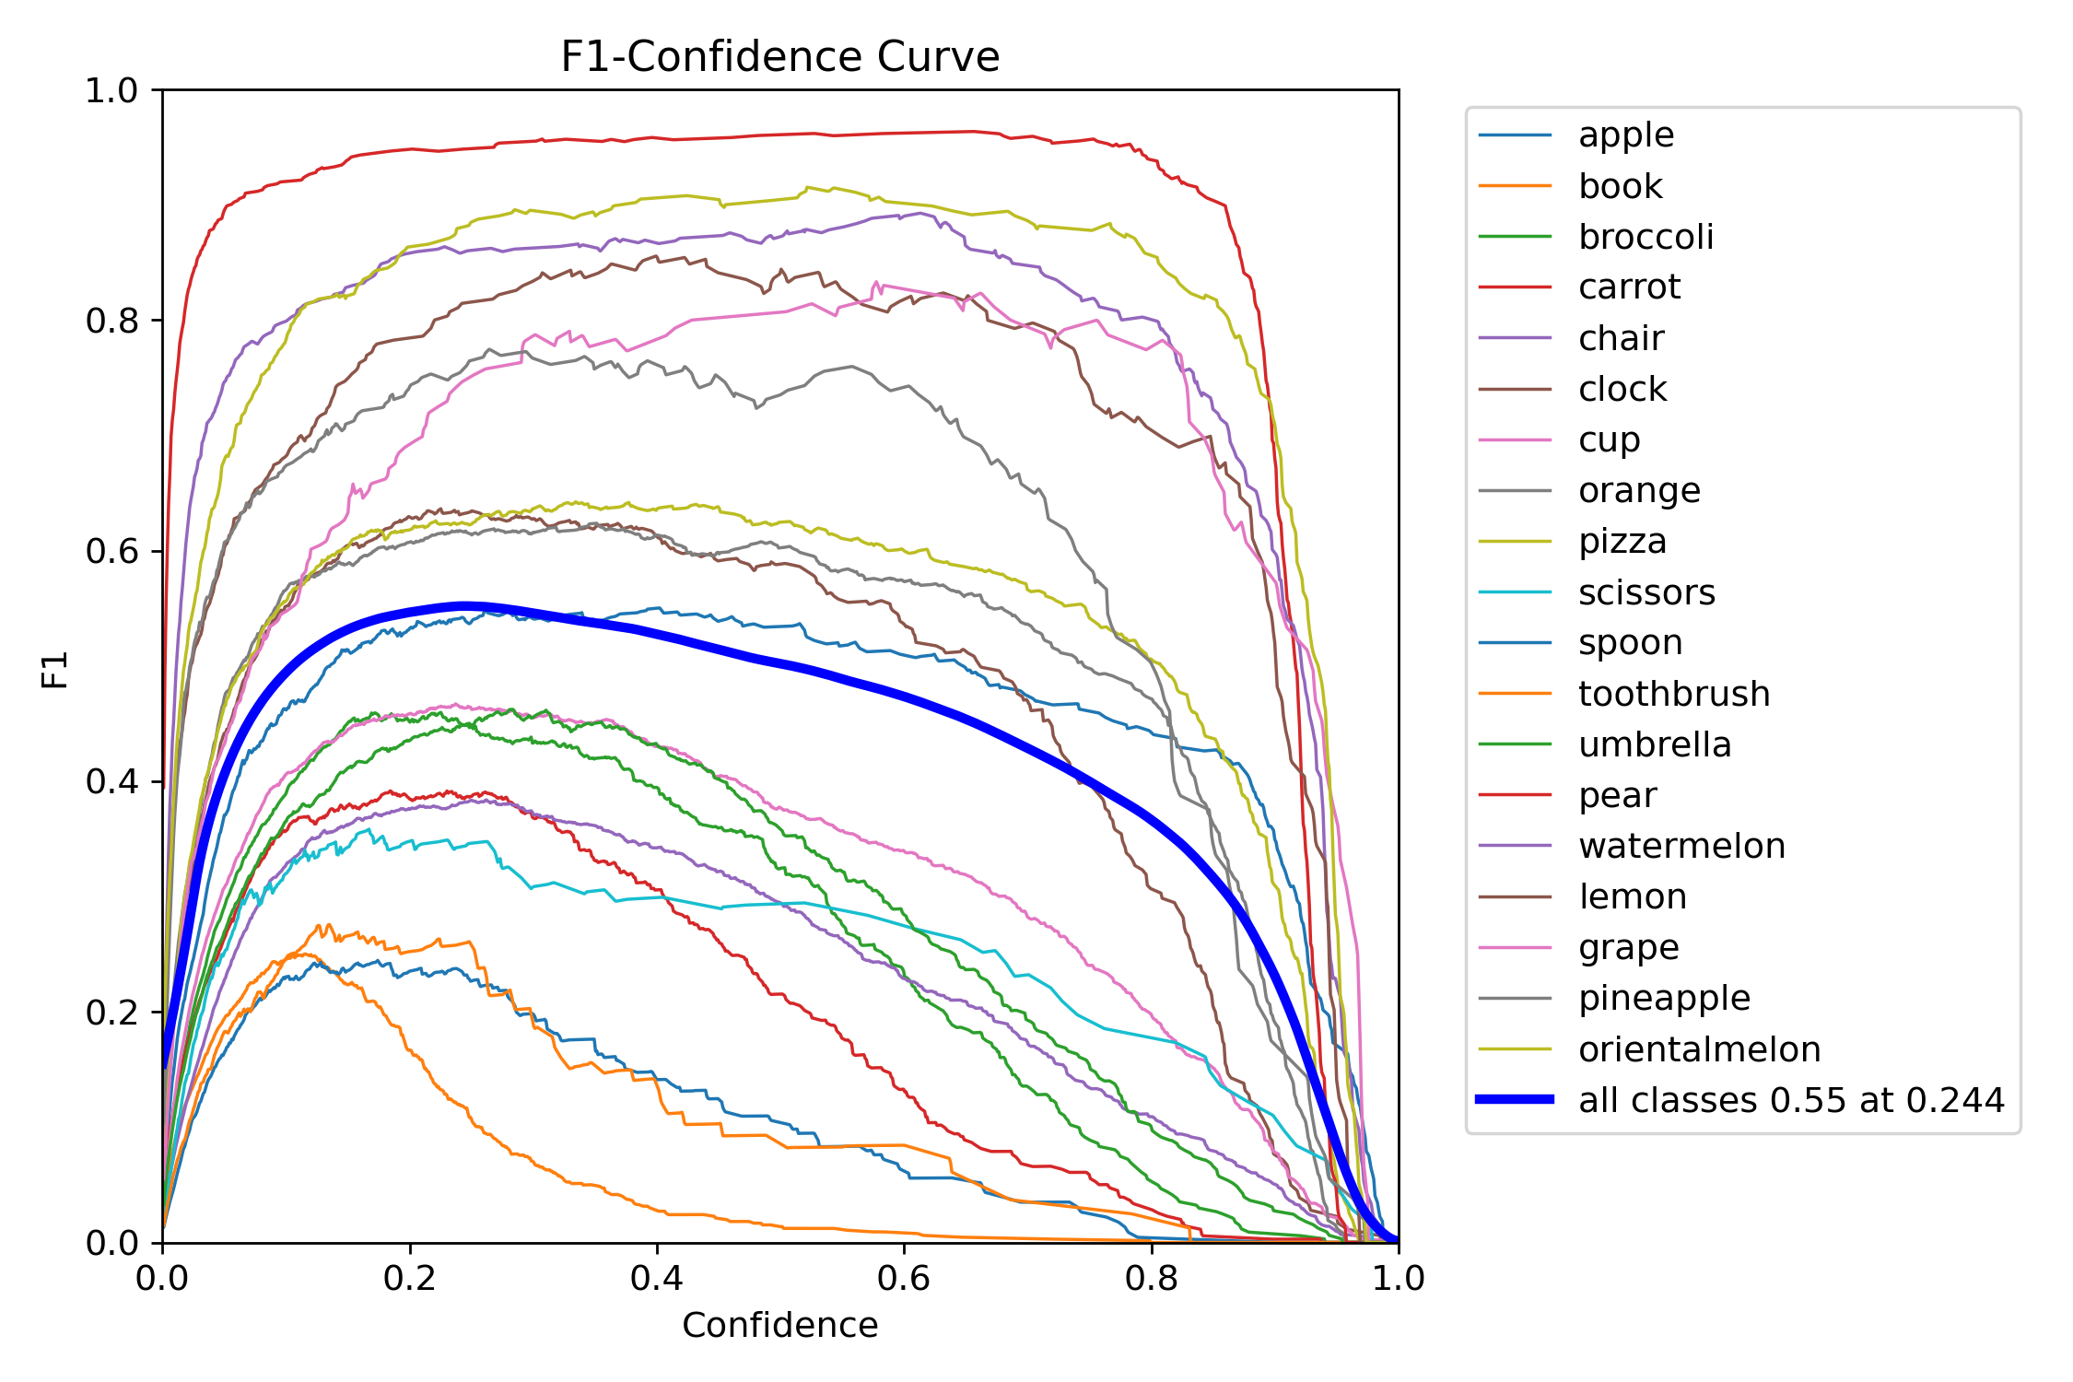
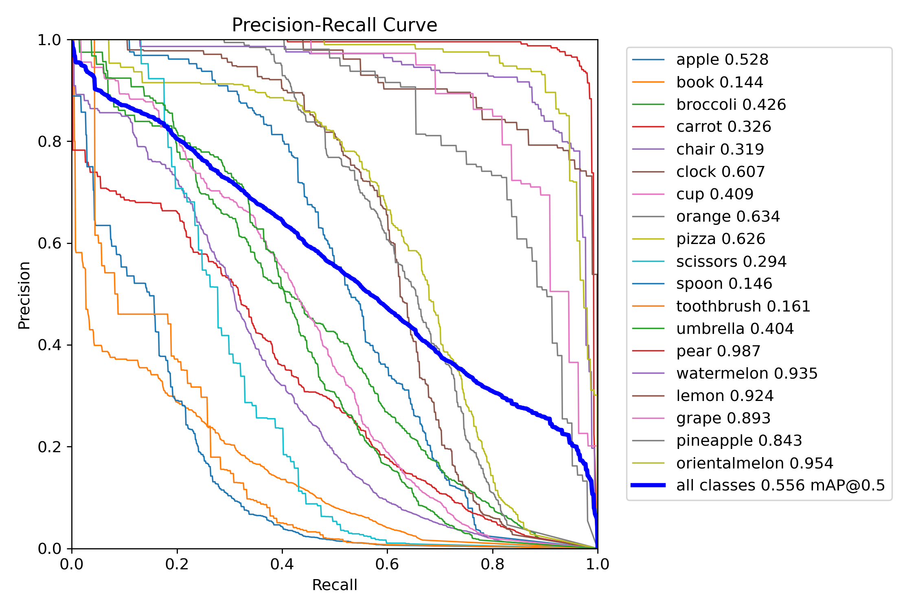
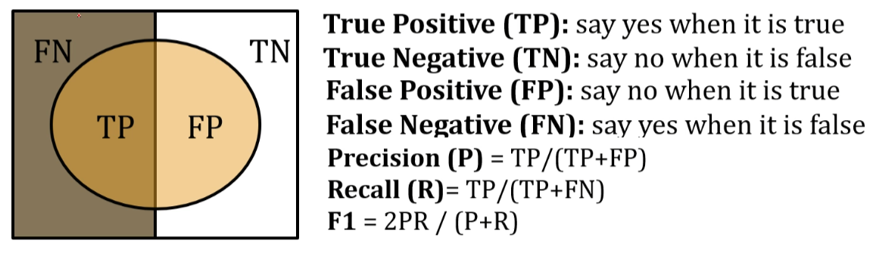
Model Evaluation
Notes:
For evaluation of model, we used precision-recall graph and f1-score graph for each class.
As we learned in previous lecture, precision can be calculated by using the ratio of the correct answers among the predictions of positive.
And recall can be calculated by using the ratio of finding the real one out of the actual positives model have.
And F1 score is harmonized mean of Precision and Recall.
So, left side is precision-recall grap and right side is f1-score graph. As you can see some classes have low f1 score about 0.2. So, we should find reasons and supplement about it for the final model.
Precision - Positive라고 예측한것들 중에서 정답을 잘 맞추었는지의 비율
Recall - 본래 내가 가진 실제 Positive 중에서 진짜를 찾아낸 비율
F1 - Precision과 Recall의 조화평균

Slide 10
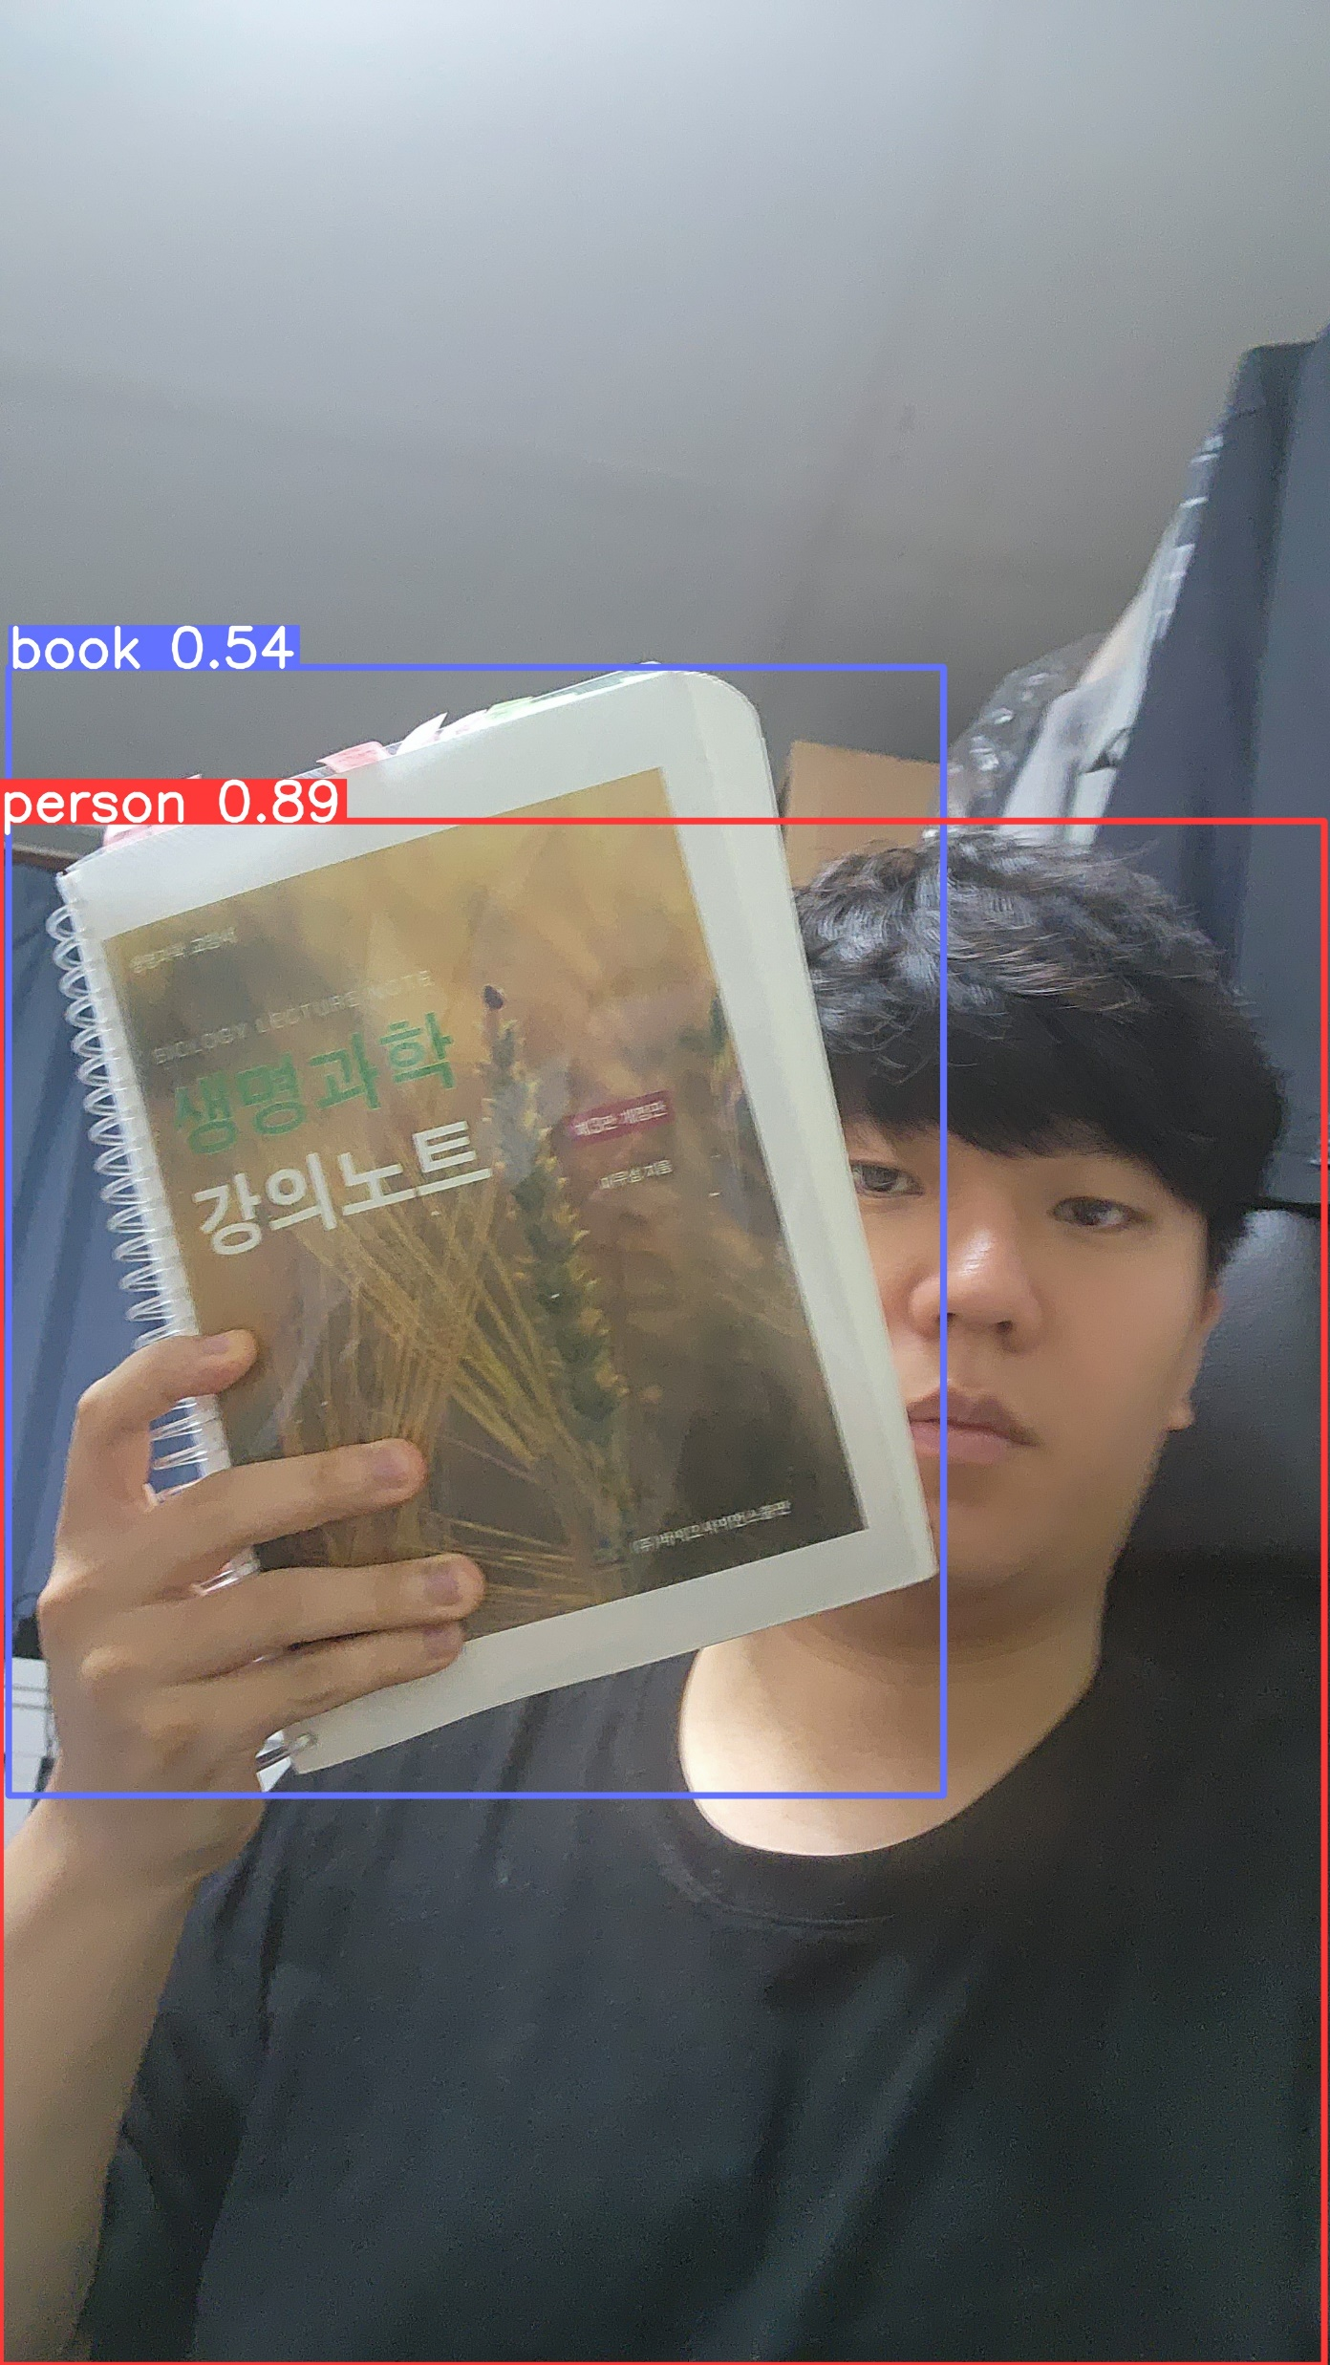
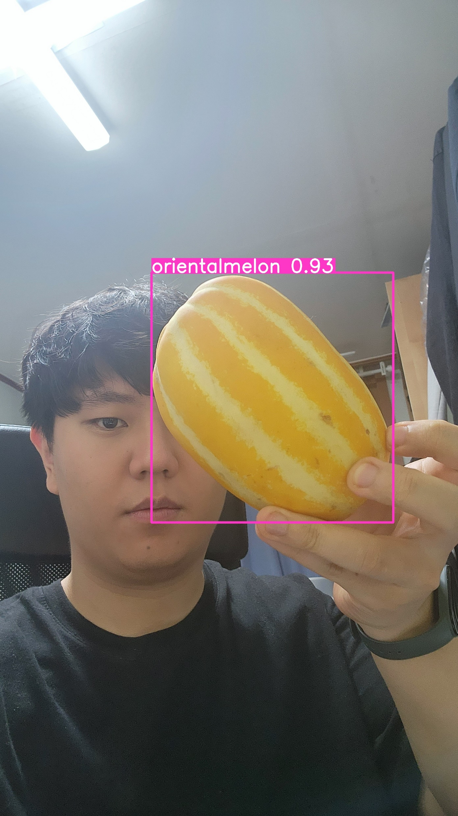
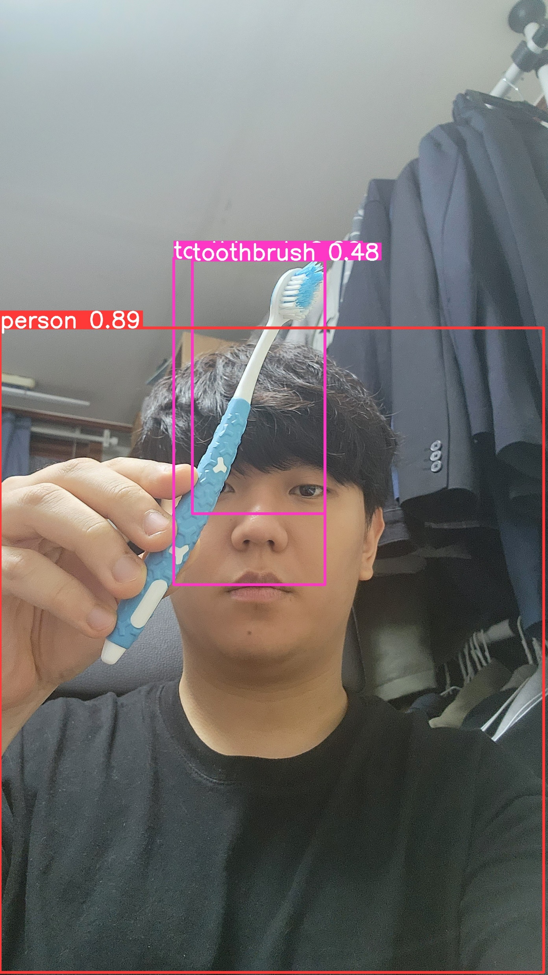
Real Test
Notes:
This shows real detection test using webcam. Exept some classes, model can detect well for most of rest classes.

Slide 11
Things To Be Continued…
Improve Dataset classes which have low accuracy
→Verify quality of dataset , Add more dataset , etc…
Increase Epoch to 100↑(About 10 hours)
Connect with Front-end Web Page
Notes:
So this is thing to be continued, which is our final goal.
First, we will improve dataset classes which have low accuracy, as you saw in previous slide. We are considering verify quality of dataset or add more dataset.
And, we will increase epoch to 100, because of training time, about 6 minutes per one epoch, we trained just 20 epoch to make test model. We will make this to 100 to make our final model.
And finally, we will connect yolo model to front-end web page.

Slide 12
Server

Slide 13
Q&A

